Slide 1

“CyberKnights”
Dec - 2023
Vinod Kumar
Aviral Singh
Vinay Somawat
Salamuddin
Richa Upadhyay
Bhupendra Rawat

Slide 2
Security Dashboard for PII Data Monitoring
Need to detect and Monitor suspicious activities related to Personally Identifiable Information (PII) access in real-time by providing an alert monitoring system.
Monitor and analyze reported cases of data leaks (AWB cases) by providing a tool that can generate detailed information about AWB and PII accessed by internal Users .
Proactively manage user accounts and enhance security by identifying dormant users who haven't been active for an extended period.

Slide 3
Research and Analysis
Review & Analysis:
Explored problem statement internally and externally.
Analyzed current PII data access within our system.
Discussions:
Engaged with champions and cybersecurity experts.
Gained practical insights and identified key system requirements.
Case Studies:
Examined current PII cases and manual reporting solutions.
Insights Gained:
Holistic problem understanding.
Expert perspectives for informed decision-making.
Real-world case studies informing our solution.

Slide 4
Solution Overview
Introducing Cyberरक्षक
Key Features:
PII Surveillance Dashboard:
Real-time detection and monitoring functionality.
Monitors APIs exposing Potential PII Data.
User Tracking at AWB Level:
Tracks user activities based on AWB level PII access.
Provides comprehensive insights into user behavior.
Alert Generation:
Generates alerts for users accessing alarming rates of PII.
Ensures proactive response to potential security threats.
Advantages:
Enhanced Visibility: Real-time surveillance for PII exposure.
User Behavior Insights: AWB level tracking for detailed user analysis.
Proactive Security: Immediate alerts for suspicious user activities.

Slide 5
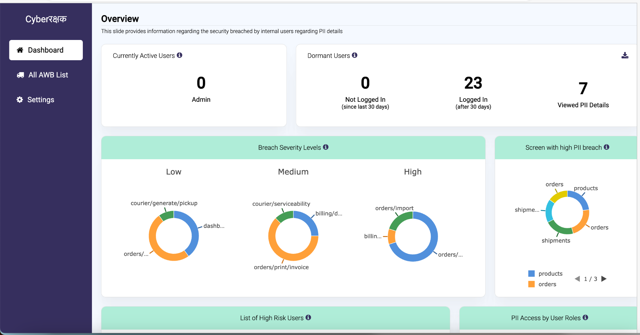

Slide 6
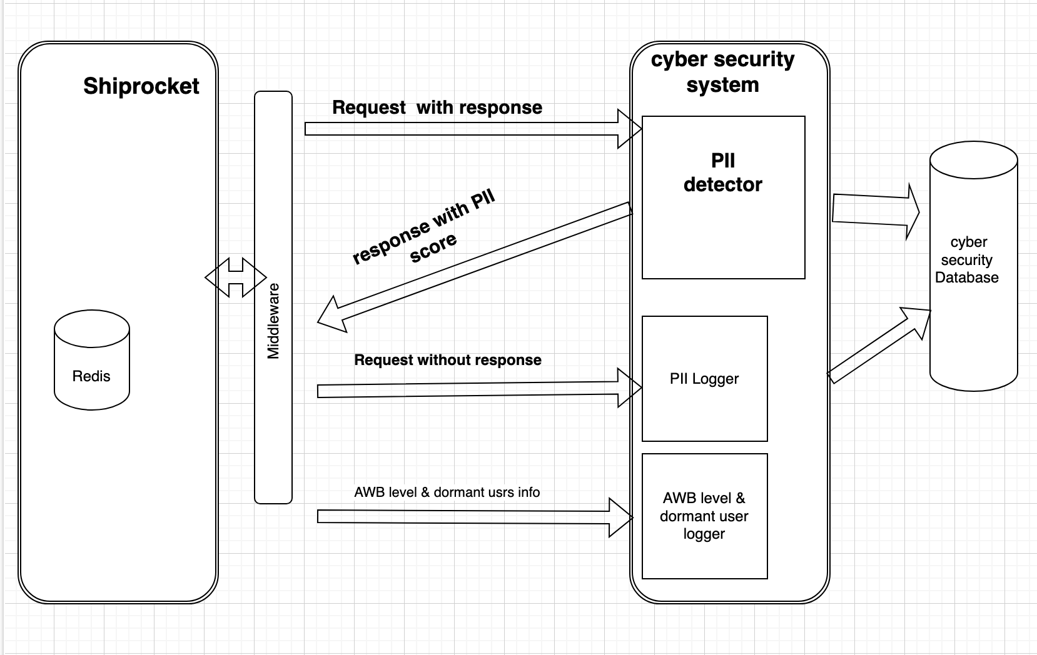
Technical Architecture
Tech stack Front end : Angular , Backend : Laravel PHP

Slide 7
Business Opportunity and Future Scope
Innovation and Improvement:
Enhance role based access to panel.
Reporting and auto action if found PII breached .
Business Expansion:
Can be extended as a separate business solution to detect PII data over apis.

Slide 8
Q&A

Slide 9
Do's and Don'ts for a Crisp 10-Minute Presentation
Do's :
Plan and Practice: Prepare your content ahead and practice to ensure you stay within the 10-minute timeframe.
Clear Structure: Have a clear beginning, middle, and end. Structure your content logically.
Concise Points: Stick to key points and avoid overloading with information. Be succinct.
Don'ts:
Avoid Overloading Slides: Do not cram too much information or text onto your slides.
Don’t Ignore Timing: Do not overlook the importance of sticking to your 10-minute limit.
Avoid Last-Minute Changes: Making changes at the last minute can throw off your timing and delivery.

